Slide 1
Introduction to NLP
Question Answering
[includes slides by Talley Amir]

Slide 2
What is Question Answering?
Question answering (QA), is the problem of systematically deriving an answer to a question asked in a natural language based on a knowledge source.
Hermann, Karl M. “Deep Learning for Natural Language Processing: Question Answering.” Google DeepMind. 4 March 2017.

Slide 3
types of Question Answering system
Information retrieval (IR)-based QA
Uses phrases in the question to search for keywords in vast data sources (e.g. documents in a reserve, websites on the Internet) that may contain the answer to the question. The answer-candidates are then ranked based on various metrics pertaining to the quality and relevance of the answers.
Knowledge-based QA
Translates the question into a semantic representation compatible with a database wherein the answer to the question lies. The semantic representation is then made as a query to the database, and the query-answer is then converted to a natural-language response.
Jurafsky, Daniel. Martin, James H. “Speech and Language Processing.” Third Edition. 15 August 2018: p. 376.

Slide 4
People Ask Questions Online
Excite corpus
2,477,283 queries (one day’s worth)
8.4% of them are questions
43.9% factual (what is the country code for Belgium)
56.1% procedural (how do I get out of debt) or other

Slide 5
The Excite Corpus
In what year did baseball become an offical sport?
how do i get out of debt?
Where can I found out how to pass a drug test?
When is the Super Bowl?
who is California's District State Senator?
where can I buy extra nibs for a foutain pen?
what time is it in west samoa?
Where can I buy a little kitty cat?
what are the symptoms of attention deficit disorder?
Where can I get some information on Michael Jordan?
How does the character Seyavash in Ferdowsi's Shahnameh exhibit characteristics of a hero?
When did the Neanderthal man live?
Which Frenchman declined the Nobel Prize for Literature for ideological reasons?
Notes:
Each question can have multiple answers

Slide 6
AOL Corpus Questions
what does cerebral cortical atrophy mean
what fraction is closest to pi
what is the highest calories consumed by a person in a 24 hor period
what happens to limewater in the presence of carbon dioxide
what language is numa numa in
who discovered saturn
who discovered the gene for huntington's disease
who is the daugther of indian sitar maestro ravi Shankar
who invented marshmallow sandwich cookies
who invented lithograph
who was the first michigan football player to put on the cover of a video game
who invented smallpox vaccine
when was the berlin wall torn down
when was yahoo launched
when was the wedding march by mendelssohn composed
when was the declaration of independence signed
when did france become a republic
when was alexander the great born
which fish contains low mercury
when is the youngest a minor can move out of thier parents house in texas
when should take a child to see an psychologist
what hormone imbalance could mimic pregnancy symptoms

Slide 7
History of QA system

Slide 8
Older Systems (pre-TREC)
BASEBALL (Green et al., 1961)
Baseball
ELIZA (Weizenbaum 1966)
Dialogue, Therapist
SHRDLU (Winograd 1972)
Blocks world
LUNAR (Woods, 1973)
Lunar rocks
Murax (Kupiec 1993)
Open-domain, encyclopedia-based
START (Katz 1997)
Open-domain, web-based
Deep Red (Hirschman & al. 1999)
Reading comprehension
Jupiter (Zue et al., 2000)
Spoken questions

Slide 9
Eliza (Weizenbaum 1966)
Eliza plays a therapist
and doesn’t really answer questions ☺
Simple pattern matching
Sample dialogue
E: I am the psychotherapist. Please, describe your problems.
P: I am always tired.
E: Why do you say you are always tired?
P: Because I cannot sleep.
E: Is it because you cannot sleep that you came to me?
P: Yes, help me please.
E: Earlier you said you cannot sleep?

Slide 10
Lunar (Woods et al., 1972)
Lunar Sciences Natural Language Information System
Apollo 11 moon rocks
Questions in English
Components
a general-purpose ATN (augmented transition network) grammar for English
a procedural-semantics framework for semantic interpretation
mapping from the syntactic grammar to a logic representation
3,500 word dictionary
13,000 entries in the knowledge base
Lunar answered 78% of sentences asked by geologists at 1971 Lunar Rocks conference
How many breccias contain olivine?
What are they?

Slide 11
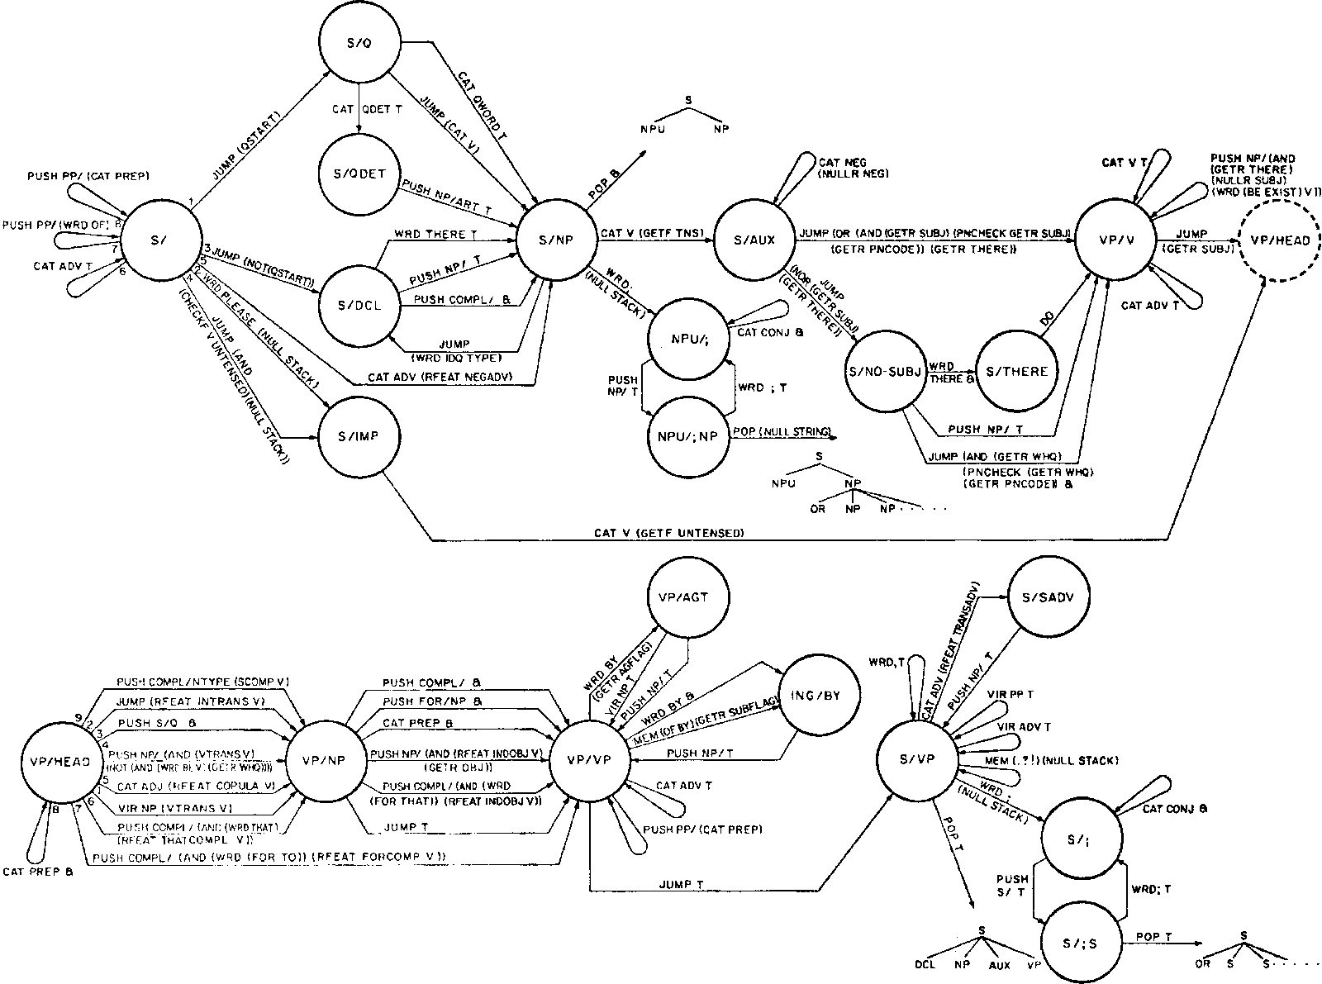
Lunar Grammar Fragment

Slide 12
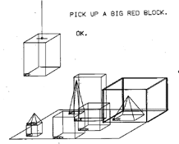
SHRDLU (Winograd 1972)
Simple questions about the blocks world
Person: Pick up a big red block.
Computer: OK.
Person: Grasp the pyramid.
Computer: I don't understand which pyramid you mean.
Person (changing their mind): Find a block which is taller than the one you are holding and put it into the box.
Computer: By "it", I assume you mean the block which is taller than the one I am holding.
Computer: OK.
Person: What does the box contain?
Computer: The blue pyramid and the blue block.
Person: What is the pyramid supported by?
Computer: The box.
Person: How many blocks are not in the box?
Computer: Four of them.
Person: Is at least one of them narrower than the one which I told you to pick up?
Computer: Yes, the red cube.
http://hci.stanford.edu/~winograd/shrdlu/

Slide 13
TREC
What date in 1989 did East Germany open the Berlin Wall?
Nov 9
Who was Johnny Mathis' high school track coach?
Lou Vasquez
What is the shape of a porpoises' tooth?
spade-shaped
What is the number of buffaloes thought to have been living in North America when Columbus landed in 1492?
60 million
The Faroes are a part of what northern European country?
Denmark
The symptoms of Parkinson's disease are linked to the demise of cells in what area of the brain?
substantia nigra
What was the date of the Chelsea flower show in 1992?
May 18
What hotel was used for a setting of the Agatha Christie novel, "And Then There Were None"?
Burgh Island Hotel
What year was the Magna Carta signed?
1215
Who was Lincoln's Secretary of State?
William Seward
How long does it take to fly from Paris to New York in a Concorde?
3 1/2 hours

Slide 14
The TREC Q&A evaluation
Run by NIST
Voorhees and Tice 1999, 2000
2GB of input
AQUAINT corpus
200 questions in 1999
693 questions in 2000
Essentially fact extraction
Who was Lincoln’s secretary of state?
What does the Peugeot company manufacture?
Assumptions
Questions are based on text
Answers are assumed to be present
Systems return five passages of 50 or 250 bytes
After 2002, only a single passage of 50 bytes + confidence score + NIL
No inference needed

Slide 15
Other Types of Questions
Definitional
What is a boll weevil?
List
Which states signed the US Declaration of Independence?
Crosslingual
E.g., questions in Spanish, documents in English
Series
Next slide

Slide 16
TREC Series Questions
What are prions made of?
Who discovered prions?
What researchers have worked with prions?
Who is the lead singer/musician in Nirvana?
Who are the band members?
When was the band formed?
What is their biggest hit?
What are their albums?
What style of music do they play?
What industry is Rohm and Haas in?
Where is the company located?
What is their annual revenue?
How many employees does it have?
What kind of insect is a boll weevil?
What type of plant does it damage?
What states have had problems with boll weevils?

Slide 17
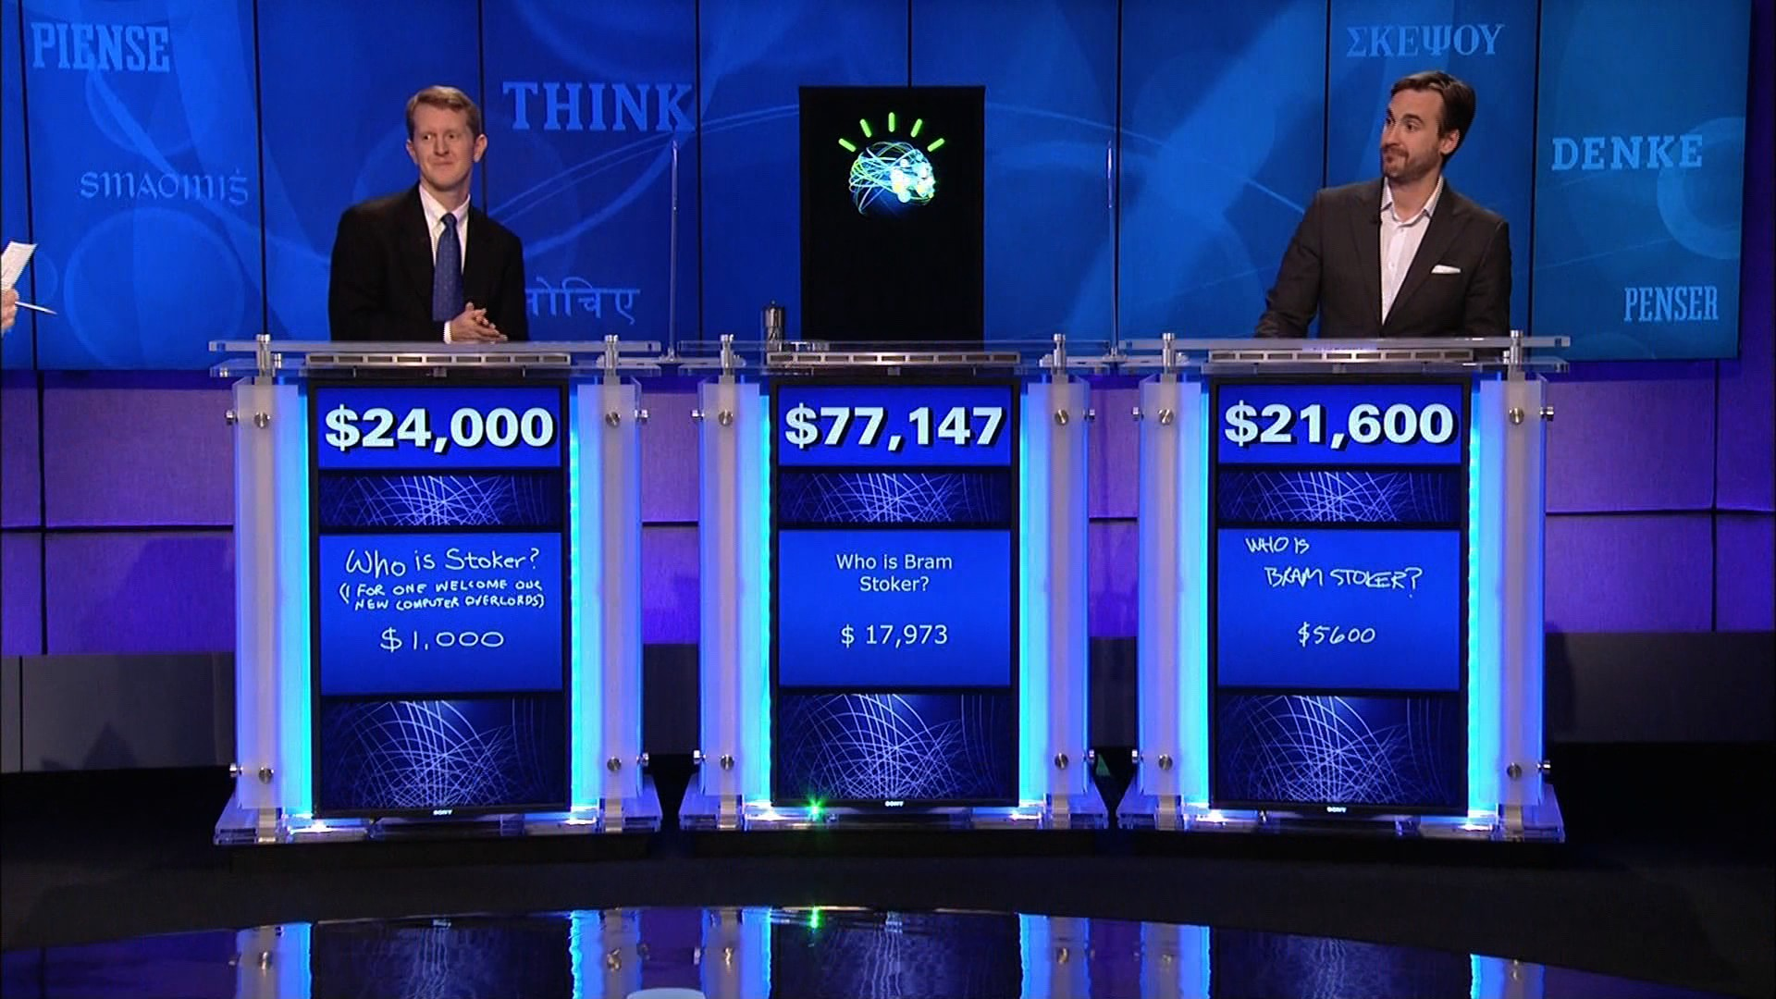
IBM’s Watson
http://www.geekwire.com/2013/ibm-takes-watson-cloud/

Slide 18
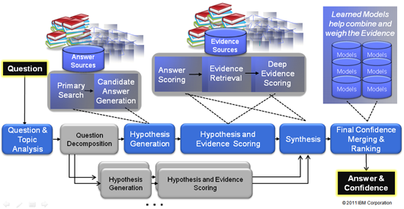
IBM Watson Architecture
[Ferrucci et al. 2011]

Slide 19
Watson (Ferrucci et al. 2010)
Jeopardy winner (2011)
Architecture
Uses "DeepQA": a technology that enables computer systems to directly and precisely answer natural language questions over an open and broad range of knowledge
10 racks of IBM Power 750 servers running Linux
16 terabytes of RAM
2,880 processor cores
Capable of operating at 80 teraflops.
Mostly in Java but also some C++ and Prolog
Integrated using UIMA
Ferrucci et al. 2010. Building Watson: An Overview of the DeepQA Project. AI Magazine. Fall 2010. 59-79.
http://www.pcmag.com/article2/0,2817,2380351,00.asp
http://blog.reddit.com/2011/02/ibm-watson-research-team-answers-your.html

Slide 20
Watson (Ferrucci et al. 2011)
Knowledge sources
200 million pages of structured and unstructured content consuming four terabytes of disk storage
Including Wikipedia, WordNet, Yago
Betting strategy
Buzz if at least 50% certain
Performance
Watson answers 66 correct and 9 incorrect.
Watson's two day winning streak was $77,147. Ken Jennings ended with $24,000 and Brad Rutter with $21,600.
http://www.quora.com/What-questions-were-asked-in-the-Jeopardy-episode-involving-Watson
http://theswimmingsubmarine.blogspot.com/2011/02/how-ibms-deep-question-answering.html
http://www.theatlantic.com/technology/archive/2011/02/is-it-time-to-welcome-our-new-computer-overlords/71388/

Slide 21
Watson (Ferrucci et al. 2011)
Question types
2,500 of them
200 of them are very common
Jeopardy Question Archive
http://j-archive.com/

Slide 22
Watson on Jeopardy
Sample questions
On December 8, 2008 this national newspaper raised its newsstand pice by 25 cents to $1
USA Today
In 2010 this former first lady published the memoir "Spoken From the Heart“
Laura Bush
This person is appointed by a testator to carry out the directions & requests in his will
Executor
Familiarity is said to breed this, from the Latin for "Despise“
Contempt
As of 2010, Croatia & Macedonia are candidates but this is the only former Yugoslav republic in the EU
Slovenia
The ancient "Lion of Nimrud" went missing from this city's national museum in 2003 (along with a lot of other stuff)
Baghdad
It's just a bloody nose! You don't have this hereditary disorder once endemic to European royalty
Haemophilia
It's Michelangelo's fresco on the wall of the Sistine Chapel, depicting the saved and the damned
The Last Judgement
She "Died in the church and was buried along with her name. Nobody came“
Eleanor Rigby
A camel is a horse designed by this
Committee

Slide 23
Watson Videos
IBM's Watson Supercomputer Destroys Humans in Jeopardy
https://www.youtube.com/watch?v=WFR3lOm_xhE
"What is IBM Watson?" 7 Videos from the Jeopardy! Era
http://mentalfloss.com/article/51543/what-ibm-watson-7-videos-jeopardy-era

Slide 24
SQuAD: 100,000+ Questions for Machine Comprehension of Text
Application
Reading comprehension, specifically applied to question-answer pairs from Wikipedia articles (cultivated in this dataset).
Challenge
Manually develop a large reading comprehension dataset of quality questions and answers, and derive a model for learning on that dataset.
Implementation
This model uses both dependency and constituency trees, as well as a strong logistic regression model.
Rajpurkar, Pranav. Zhang, Jian. Lopyrev, Konstantin. Liang, Percy. “SQuAD: 100,000+ Questions for Machine Comprehension of Text.” Stanford University, Computer Science Department. 11 October 2016.

Slide 25
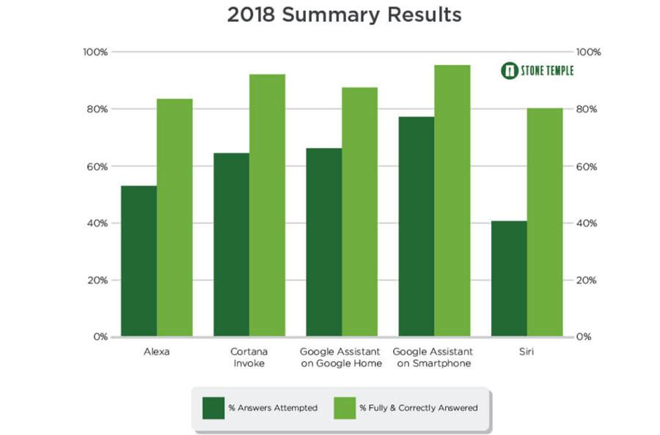
Virtual Assistants
Applications:
Command execution.
Play music, set an alarm
Simple question answering.
What is the weather like today?
Performance:

Slide 26
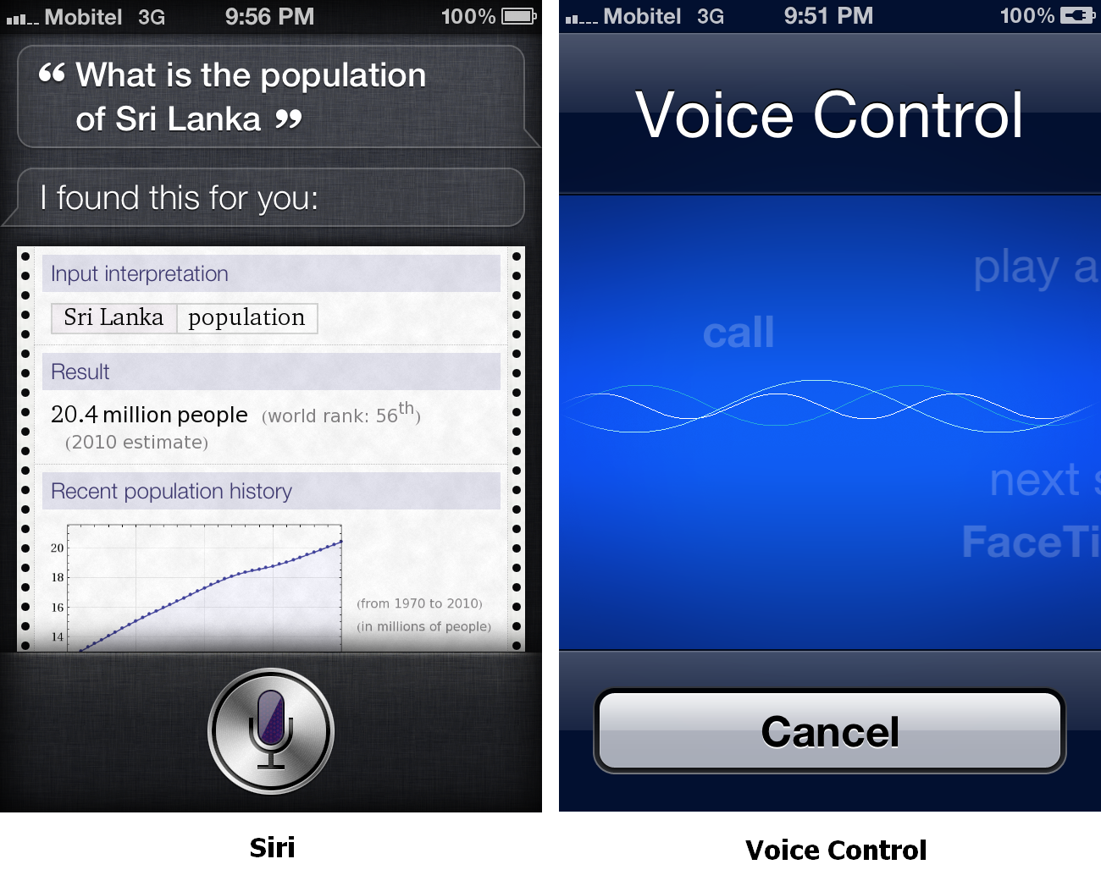
Siri

Slide 27
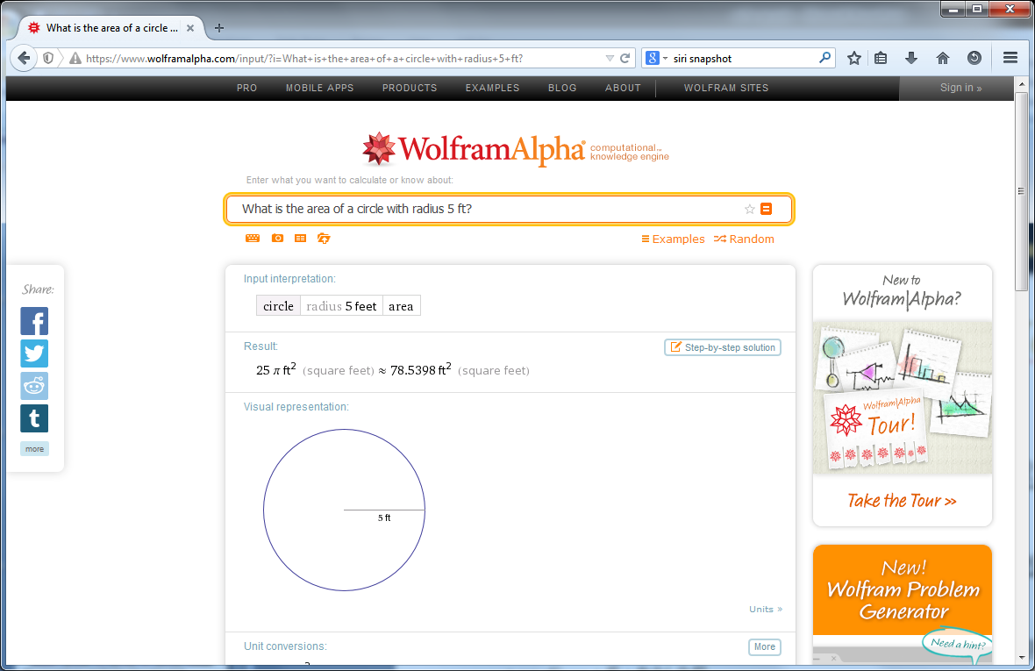
WolframAlpha

Slide 28
Evaluation of QA

Slide 29
Metrics of successful QA modeling
Relevance
Correctness
Conciseness
Completeness
Coherence
Justification
Current limitations:
Breadth versus depth
Pasupat, Panupong. “WikiTableQuestions: A Complex Real-World Question Answering Dataset.” The Stanford NLP Group. 11 February 2016.
L. Hirschman and R. Gaizauskas, ``Natural language question answering: the view from here,” JNLE, vol. 7, no. 4, pp. 275-300, 2001.

Slide 30
MRR
MRR
Mean Reciprocal Rank
Introduced by TREC
Example
What is the capital of Canada?
1.Toronto, 2.Ottawa, 3.Albany, 4.Philadelphia, 5.Ottawa
Correct answer ranks = 2, 5 (highest rank = 2)
MRR = 1/2 = 0.5
TRR = 1/2 + 1/5 = 0.7 = total reciprocal rank
Later years
Confidence-weighted score

Slide 31
IR-based Question Answering
System Architecture

Slide 32
IR-based QA Architecture
[Jurafsky and Martin book]

Slide 33
System Components
Source identification
semi-structured vs. text sources
Query modulation
best paraphrase of a NL question given the syntax of a search engine
Example: Who wrote Hamlet → author | wrote Hamlet
Document retrieval
Sentence ranking
n-gram matching, Okapi
Answer extraction
question type classification
phrase chunking
Answer ranking
question type, proximity to query words, frequency

Slide 34
What is the largest city in Northern Afghanistan?
Query modulation
(largest OR biggest) city “Northern Afghanistan”
Document retrieval
www.infoplease.com/cgi-bin/id/A0855603 www.washingtonpost.com/wp-dyn/print/world/
Sentence ranking
Gudermes, Chechnya's second largest town … location in Afghanistan's outlying regions
within three miles of the airport at Mazar-e-Sharif, the largest city in northern Afghanistan
Answer extraction
Gudermes
Mazer-e-Sharif
Answer ranking
Mazer-e-Sharif
Gudermes

Slide 35
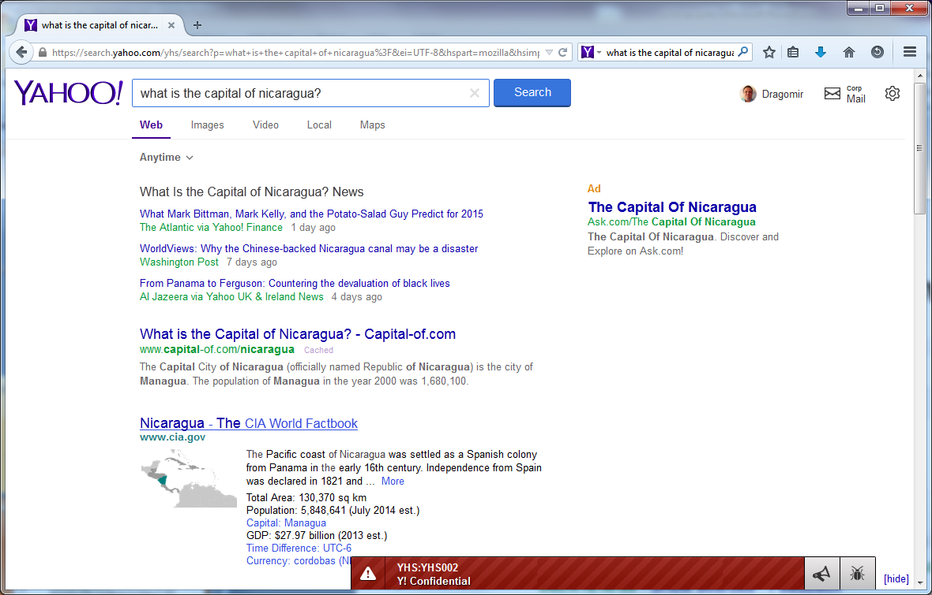
System Architecture
Many questions can be answered by traditional search engines

Slide 36
What is the Largest City in Northern Afghanistan?
... Afghanistan, Kabul, 2,450 ... Administrative capital and largest city (1997 est ... Undetermined. Panama, Panama City, 450,668. ... of the Gauteng, Northern Province, Mpumalanga ... www.infoplease.com/cgi-bin/id/A0855603
... died in Kano, northern Nigeria's largest city, during two days of anti-American riots led by Muslims protesting the US-led bombing of Afghanistan, according to ... www.washingtonpost.com/wp-dyn/print/world/
... air strikes on the city. ... the Taliban militia in northern Afghanistan in a significant blow ... defection would be the largest since the United States ... www.afgha.com/index.php - 60k
... Kabul is the capital and largest city of Afghanistan. . ... met. area pop. 2,029,889), is the largest city in Uttar Pradesh, a state in northern India. . ... school.discovery.com/homeworkhelp/worldbook/atozgeography/ k/k1menu.html
... Gudermes, Chechnya's second largest town. The attack ... location in Afghanistan's outlying regions ... in the city of Mazar-i-Sharif, a Northern Alliance-affiliated ... english.pravda.ru/hotspots/2001/09/17/
... Get Worse By RICK BRAGG Pakistan's largest city is getting a jump on the ... Region: Education Offers Women in Northern Afghanistan a Ray of Hope. ... www.nytimes.com/pages/world/asia/
... within three miles of the airport at Mazar-e-Sharif, the largest city in northern Afghanistan, held since 1998 by the Taliban. There was no immediate comment ... uk.fc.yahoo.com/photos/a/afghanistan.html

Slide 37
Question Type Taxonomy
Question Types
Yes/no vs. wh-
Factual vs. procedural
Single answer vs. multiple answers
Objective vs. subjective
Context-specific (personalized) vs. generic
Known answer in the collection, y/n

Slide 38
Question Type Classification
Can help find the right answers in the text
Example
Who wrote Anna Karenina?
Looking for a PERSON/INDIVIDUAL/WRITER

Slide 39
SYN-classes (IBM AnSel)
QA-token
Question type
Example
PLACE
Where?
In the Rocky Mountains
COUNTRY
Where? What country?
United Kingdom
STATE
Where? What state?
Massachusetts
PERSON
Who?
Albert Einstein
ROLE
Who?
Doctor
NAME
Who? What? Which?
The Shakespeare Festival
ORG
Who? What?
The U.S. Post Office
DURATION
How long?
For 5 centuries
AGE
How old?
30 years old
YEAR
When? What year?
1999
TIME
When? What time?
In the afternoon
DATE
When? What date?
July 4th, 1776
VOLUME
How big? How large?
3 gallons
AREA
How big? How large?
4 square inches
LENGTH
How long? How big?
3 miles
WEIGHT
How heavy? How big?
25 tons
NUMBER
How many?
1,134.5
RATE
How much? What percentage?
50 per cent
MONEY
How much?
4 million dollars

Slide 40
UIUC Question Types
ENTITY: entities
animal: animals
body: organs of body
color: colors
creative: inventions, books and other creative pieces
currency: currency names
dis.med.: diseases and medicine
event: events
food: food
instrument: musical instrument
lang: languages
letter: letters like a-z
other: other entities
plant: plants
product: products
religion: religions
sport: sports
substance: elements and substances
symbol: symbols and signs
technique: techniques and methods
term: equivalent terms
vehicle: vehicles
word: words with a special property
ABBREVIATION: abbreviation
abb: abbreviation
exp: expression abbreviated
DESCRIPTION: description and abstract concepts
definition: definition of sth.
description: description of sth.
manner: manner of an action
reason: reasons
HUMAN: human beings
group: a group or organization of persons
ind: an individual
title: title of a person
description: description of a person
LOCATION: locations
city: cities
country: countries
mountain: mountains
other: other locations
state: states
NUMERIC: numeric values
code: postcodes or other codes
count: number of sth.
date: dates
distance: linear measures
money: prices
order: ranks
other: other numbers
period: the lasting time of sth.
percent: fractions
speed: speed
temp: temperature
size: size, area and volume
weight: weight

Slide 41
UIUC Examples
NUM:date
When did Rococo painting and architecture flourish ?
LOC:country
What country 's national passenger rail system is called Via ?
HUM:ind
Who invented Make-up ?
DESC:desc
What is the origin of the word `` attic '' ?
DESC:desc
What did Delilah do to Samson 's hair ?
ENTY:animal
What kind of animals were in the Paleozoic era ?
HUM:ind
Which of the following was Rhodes Scholar ?
HUM:ind
Who comprised the now-defunct comic book team known as the Champions ?
DESC:manner
How do you make a paintball ?
LOC:state
What U.S. state is Fort Knox in ?
ENTY:animal
What is a female rabbit called ?
LOC:mount
Where is the highest point in Japan ?
DESC:desc
Where do chihuahuas come from ?
LOC:other
Where does Barney Rubble go to work after he drops Fred off in the “Flintstones” cartoon series?

Slide 42
Techniques for Question Classification
Classification task
Use standard techniques such as SVM, NB
Regular expressions
WHO is|was -> PERSON
WHICH STATE -> STATE

Slide 43
Passage Retrieval
Features
Proper nouns that match the query
Near each other
Entities that match the expected answer type

Slide 44
Answer Retrieval
Use NER to identify the matching phrases
E.g., “January 1, 1951” as a DATE
Features
Distance to query words
Answer type
Wordnet similarity
Redundancy

Slide 45
n-gram tiling: Redundancy
When did French revolutionaries storm the Bastille?
The storming of the Bastille occurred in Paris on the morning of 14 July 1789
The storming of the Bastille, 14 July 1789
The storming of the Bastille prison on July 14th 1789 was an event that paved the way to further civil disorder and upheaval in France.
French revolutionaries storm Bastille, 1789
The storming of the Bastille (Louis XVI's prison) by French revolutionaries took place on July 14th, 1789
only in Web search based on redundancy.
n-gram mining (extracts all unigrams, bigrams, and trigrams from the snippets from web).
n-gram filtering (n-grams are scored based on answer type match).
n-gram tiling (greedy algorithm: start with highest-score n-gram and combine other n-grams to form longer sentence, removing lower-scoring n-gram and adding higher-scoring n-gram until a final answer is constructed )

Slide 46
QA datasets

Slide 47
bAbI QA (Facebook AI)
John picked up the apple.
John went to the office.
John went to the kitchen.
John dropped the apple.
Q: Where was the apple before the kitchen?
A: office
https://research.fb.com/downloads/babi/

Slide 48
bAbI datasets
1 So they had to fall a long way .
2 So they got their tails fast in their mouths .
3 So they could n't get them out again .
4 That 's all .
5 `` Thank you , " said Alice , `` it 's very interesting .
6 I never knew so much about a whiting before . "
7 `` I can tell you more than that , if you like , " said the Gryphon .
8 `` Do you know why it 's called a whiting ? "
9 `` I never thought about it , " said Alice .
10 `` Why ? "
11 `` IT DOES THE BOOTS AND SHOES . '
12 the Gryphon replied very solemnly .
13 Alice was thoroughly puzzled .
14 `` Does the boots and shoes ! "
15 she repeated in a wondering tone .
16 `` Why , what are YOUR shoes done with ? "
17 said the Gryphon .
18 `` I mean , what makes them so shiny ? "
19 Alice looked down at them , and considered a little before she gave her answer .
20 `` They 're done with blacking , I believe . "
Query: `` Boots and shoes under the sea , " the XXXXX went on in a deep voice , `` are done with a whiting ".
Candidates: Alice|BOOTS|Gryphon|SHOES|answer|fall|mouths|tone|way|whiting
Answer: gryphon

Slide 49
bAbI datasets

Slide 50
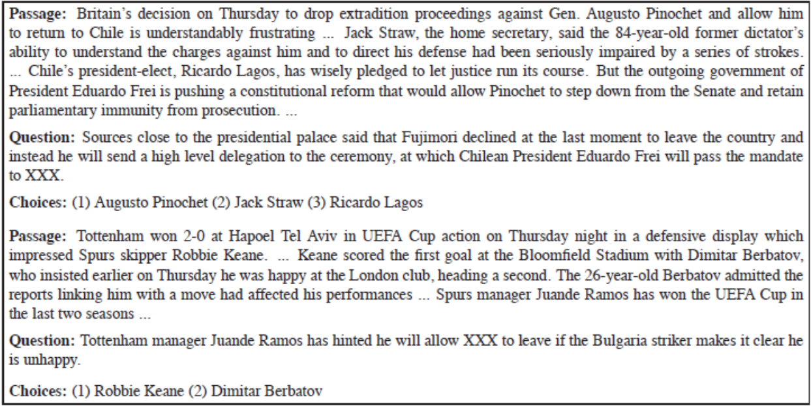
‘Who Did What’ dataset

Slide 51
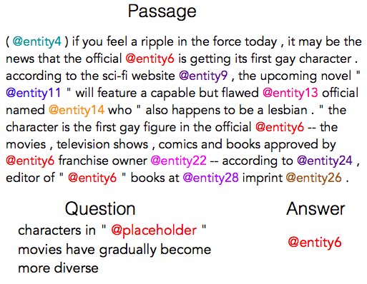
CNN/Daily Mail datasets
https://github.com/deepmind/rc-data
https://cs.nyu.edu/~kcho/DMQA/
https://paperswithcode.com/sota/question-answering-on-cnn-daily-mail

Slide 52
MS Marco dataset
"A corporation is a company or group of people authorized to act as a single entity and recognized as such in law.“
"url“ :
"http://www.wisegeek.com/what-is-a-corporation.htm",
"passage_text“ :
"A company is incorporated in a specific nation, often within the bounds of a smaller subset of that nation, such as a state or province. The corporation is then governed by the laws of incorporation in that state. A corporation may issue stock, either private or public, or may be classified as a non-stock corporation. If stock is issued, the corporation will usually be governed by its shareholders, either directly or indirectly.
"query“ :
". what is a corporation?“
"query_id“ :
1102432
"query_type“ :
"DESCRIPTION"
http://www.msmarco.org/leaders.aspx

Slide 53
EMR QA dataset
[Pampari et al. 2018]

Slide 54
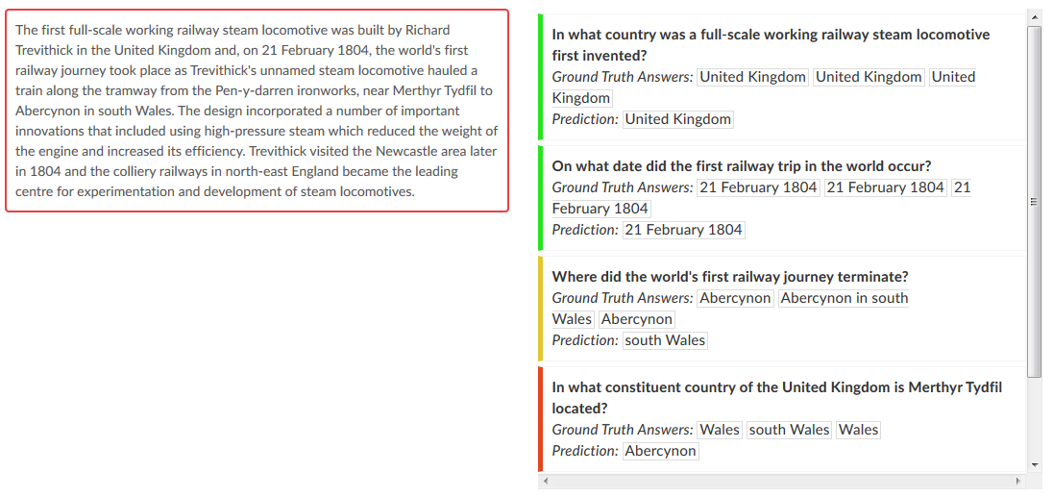
Stanford QA corpus
[Rajpurkar et al. 2016]

Slide 55
(SQuAD): 100,000+ Questions for Machine Comprehension of Text
Application
Reading comprehension, specifically applied to question-answer pairs from Wikipedia articles (cultivated in this dataset).
Challenge
Manually develop a large reading comprehension dataset of quality questions and answers, and derive a model for learning on that dataset.
Implementation
This model uses both dependency and constituency trees, as well as a strong logistic regression model.
Rajpurkar, Pranav. Zhang, Jian. Lopyrev, Konstantin. Liang, Percy. “SQuAD: 100,000+ Questions for Machine Comprehension of Text.” Stanford University, Computer Science Department. 11 October 2016.

Slide 56
(SQuAD): 100,000+ Questions for Machine Comprehension of Text
Existing Datasets:
Hirschman et al. (1999)
Later improved: Riloff and Thelen (2000); Ng et al. (2000)
Richardson et al. (2013): MCTest
Later improved: Narasimhan and Barzilay (2015); Sachan et al. (2015); Wang et al. (2015)
Both data sets are too small to extend to more “expressive” QA modeling systems.
Rajpurkar, Pranav. Zhang, Jian. Lopyrev, Konstantin. Liang, Percy. “SQuAD: 100,000+ Questions for Machine Comprehension of Text.” Stanford University, Computer Science Department. 11 October 2016.

Slide 57
MCTest comprehension data
James the Turtle was always getting in trouble. Sometimes he'd reach into the freezer and empty out all the food. Other times he'd sled on the deck and get a splinter. His aunt Jane tried as hard as she could to keep him out of trouble, but he was sneaky and got into lots of trouble behind her back.
One day, James thought he would go into town and see what kind of trouble he could get into. He went to the grocery store and pulled all the pudding off the shelves and ate two jars. Then he walked to the fast food restaurant and ordered 15 bags of fries. He didn't pay, and instead headed home.
His aunt was waiting for him in his room. She told James that she loved him, but he would have to start acting like a well-behaved turtle. After about a month, and after getting into lots of trouble, James finally made up his mind to be a better turtle.
Q: What did James pull off of the shelves in the grocery store?
A) pudding B) fries C) food D) splinters
(Richardson et al.)

Slide 58
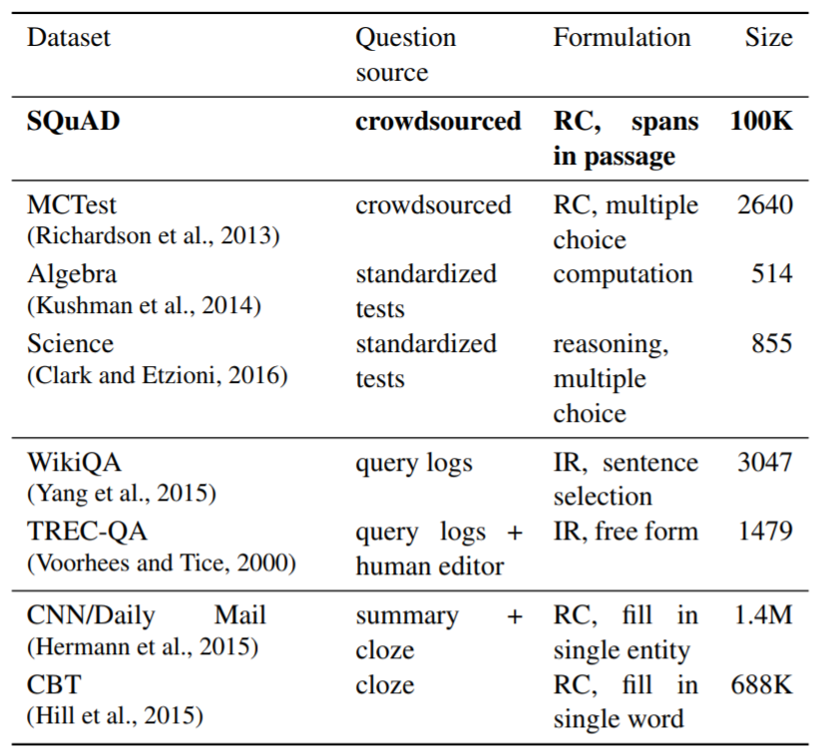
(SQuAD): 100,000+ Questions for Machine Comprehension of Text
Rajpurkar, Pranav. Zhang, Jian. Lopyrev, Konstantin. Liang, Percy. “SQuAD: 100,000+ Questions for Machine Comprehension of Text.” Stanford University, Computer Science Department. 11 October 2016.
Notes:
(Table): “A survey of several reading comprehension and question answering datasets. SQuAD is much larger than all datasets except the semi-synthetic cloze-style datasets, and it is similar to TREC-QA in the open-endedness of the answers.” Ibid.

Slide 59
(SQuAD): 100,000+ Questions for Machine Comprehension of Text
How questions were formulated:
Randomly selected 536 of the 10,000 most visited Wikipedia pages.
Passages of sufficient length were divided into: training set, development set, or test set.
Crowdworkers generated questions that could be answered with a span of text from the passage.
Other crowdworkers were then used to select alternate answer choices (spans from the text)
Rajpurkar, Pranav. Zhang, Jian. Lopyrev, Konstantin. Liang, Percy. “SQuAD: 100,000+ Questions for Machine Comprehension of Text.” Stanford University, Computer Science Department. 11 October 2016.

Slide 60
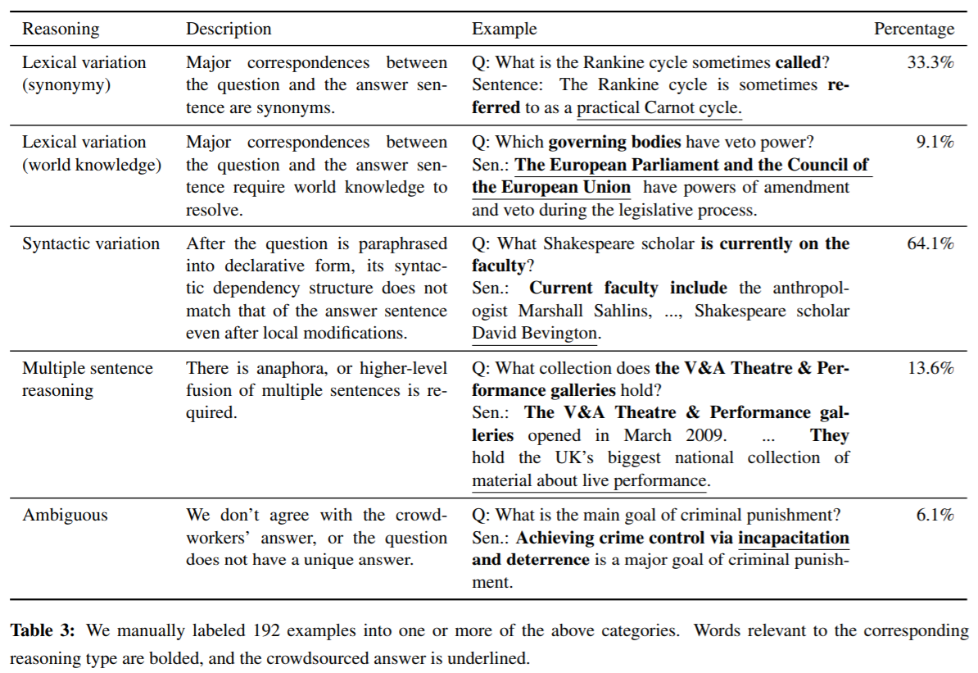
(SQuAD): 100,000+ Questions for Machine Comprehension of Text
Rajpurkar, Pranav. Zhang, Jian. Lopyrev, Konstantin. Liang, Percy. “SQuAD: 100,000+ Questions for Machine Comprehension of Text.” Stanford University, Computer Science Department. 11 October 2016.
Notes:
(Table): “A survey of several reading comprehension and question answering datasets. SQuAD is much larger than all datasets except the semi-synthetic cloze-style datasets, and it is similar to TREC-QA in the open-endedness of the answers.” Ibid.

Slide 61
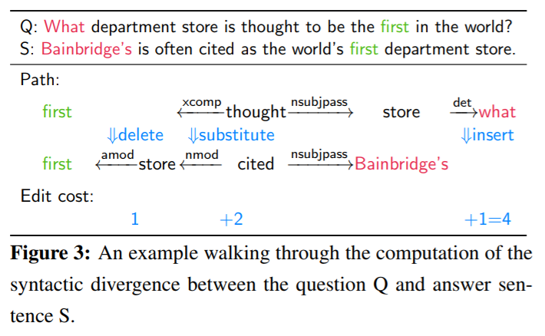
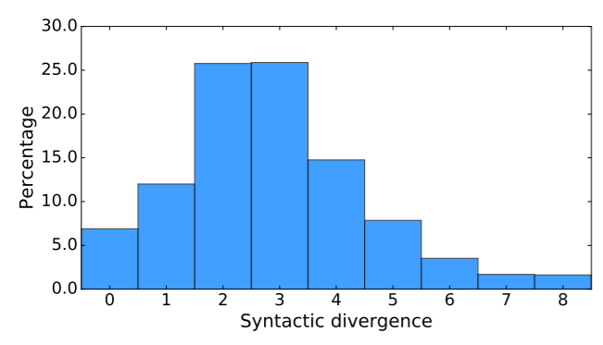
(SQuAD): 100,000+ Questions for Machine Comprehension of Text
Measurement of syntactic divergence:
Rajpurkar, Pranav. Zhang, Jian. Lopyrev, Konstantin. Liang, Percy. “SQuAD: 100,000+ Questions for Machine Comprehension of Text.” Stanford University, Computer Science Department. 11 October 2016.

Slide 62
(SQuAD): 100,000+ Questions for Machine Comprehension of Text
Method:
Develop a set of candidate sentence spans using Stanford CoreNLP.
Apply sliding window approach (Richardson et al.) to get best candidates.
Apply logistic regression model.
Evaluate performance.
Rajpurkar, Pranav. Zhang, Jian. Lopyrev, Konstantin. Liang, Percy. “SQuAD: 100,000+ Questions for Machine Comprehension of Text.” Stanford University, Computer Science Department. 11 October 2016.

Slide 63
(SQuAD): 100,000+ Questions for Machine Comprehension of Text
Logistic regression model:
Candidate answers were evaluated based on certain features.
The model was then trained on the answer choices using AdaGrad (gradient-based optimization algorithm).
L₂ regularization is used in training the model.
Features:
Matching Word/Bigram Frequencies
Root Match
Lengths
Span Word Frequencies
Constituent Label
Span POS Tags
Lexicalized
Dependency Tree Paths
Rajpurkar, Pranav. Zhang, Jian. Lopyrev, Konstantin. Liang, Percy. “SQuAD: 100,000+ Questions for Machine Comprehension of Text.” Stanford University, Computer Science Department. 11 October 2016.

Slide 64
(SQuAD): 100,000+ Questions for Machine Comprehension of Text
Experiments and results:
Used exact match and F1 score to evaluate accuracy.
The results of the logistic regression model were compared with both baseline performance and human performance.
A procedure called “feature ablations” was used to determine on which features the model performed the highest.
The authors also analyzed performance based on answer type.
Rajpurkar, Pranav. Zhang, Jian. Lopyrev, Konstantin. Liang, Percy. “SQuAD: 100,000+ Questions for Machine Comprehension of Text.” Stanford University, Computer Science Department. 11 October 2016.

Slide 65
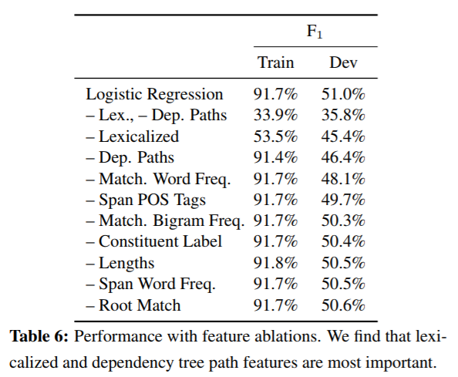
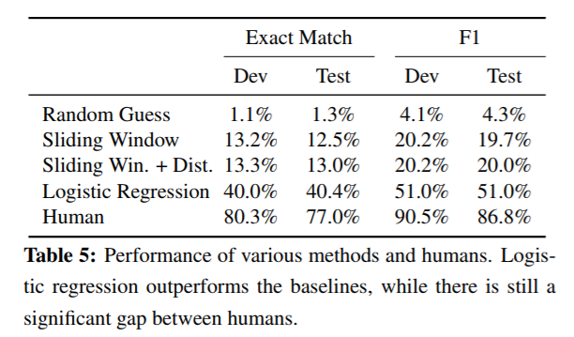
(SQuAD): 100,000+ Questions for Machine Comprehension of Text
Rajpurkar, Pranav. Zhang, Jian. Lopyrev, Konstantin. Liang, Percy. “SQuAD: 100,000+ Questions for Machine Comprehension of Text.” Stanford University, Computer Science Department. 11 October 2016.

Slide 66
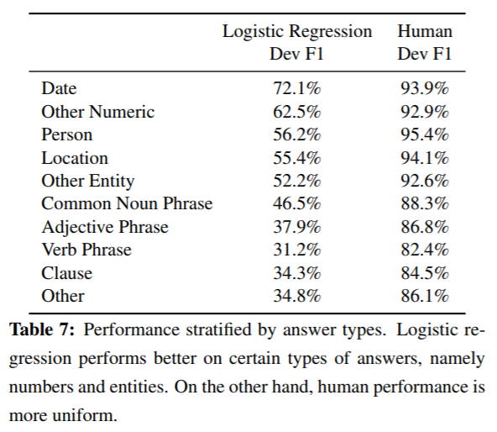
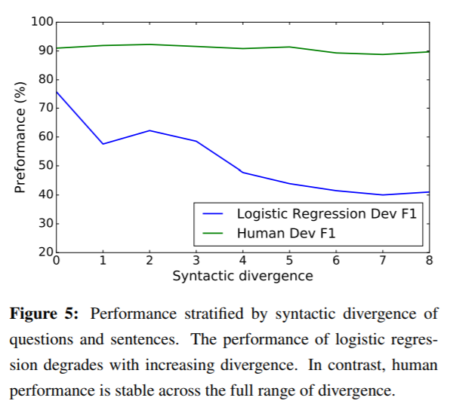
(SQuAD): 100,000+ Questions for Machine Comprehension of Text
Rajpurkar, Pranav. Zhang, Jian. Lopyrev, Konstantin. Liang, Percy. “SQuAD: 100,000+ Questions for Machine Comprehension of Text.” Stanford University, Computer Science Department. 11 October 2016.

Slide 67
(SQuAD): 100,000+ Questions for Machine Comprehension of Text
Summary:
This paper contributes a question answering dataset based on Wikipedia articles that has crowdsourced question-answer pairs.
This dataset is public and many other papers use it to test their own models.
The logistic regression model outperforms the baseline, but is far from human performance.
However, since the paper was published in 2016, the gap between this model’s performance and human performance has more than halved.
Rajpurkar, Pranav. Zhang, Jian. Lopyrev, Konstantin. Liang, Percy. “SQuAD: 100,000+ Questions for Machine Comprehension of Text.” Stanford University, Computer Science Department. 11 October 2016.

Slide 68
Neural Question Answering

Slide 69
(QANTA): A Neural Network for Factoid Question Answering Over Paragraphs
Application
Answering questions from Quiz Bowl, a high school trivia competition.
The questions in this competition are pyramidal, meaning that the first clues given are very difficult, and later clues progressively become more leading.
Challenge
Develop a model that answers questions based on information that contains very limited key words pertaining to the answer.
Implementation
This model uses a dependency-tree recurrent neural net (DT-RNN) to condense the meaning of phrases into “hidden vectors.”
Iyyer, Mohit et al. “A Neural Network for Factoid Question Answering Over Paragraphs.” 2014.

Slide 70
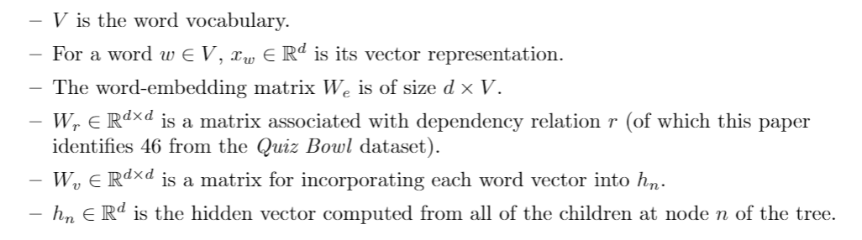
(QANTA): A Neural Network for Factoid Question Answering Over Paragraphs
Iyyer, Mohit et al. “A Neural Network for Factoid Question Answering Over Paragraphs.” 2014.

Slide 71
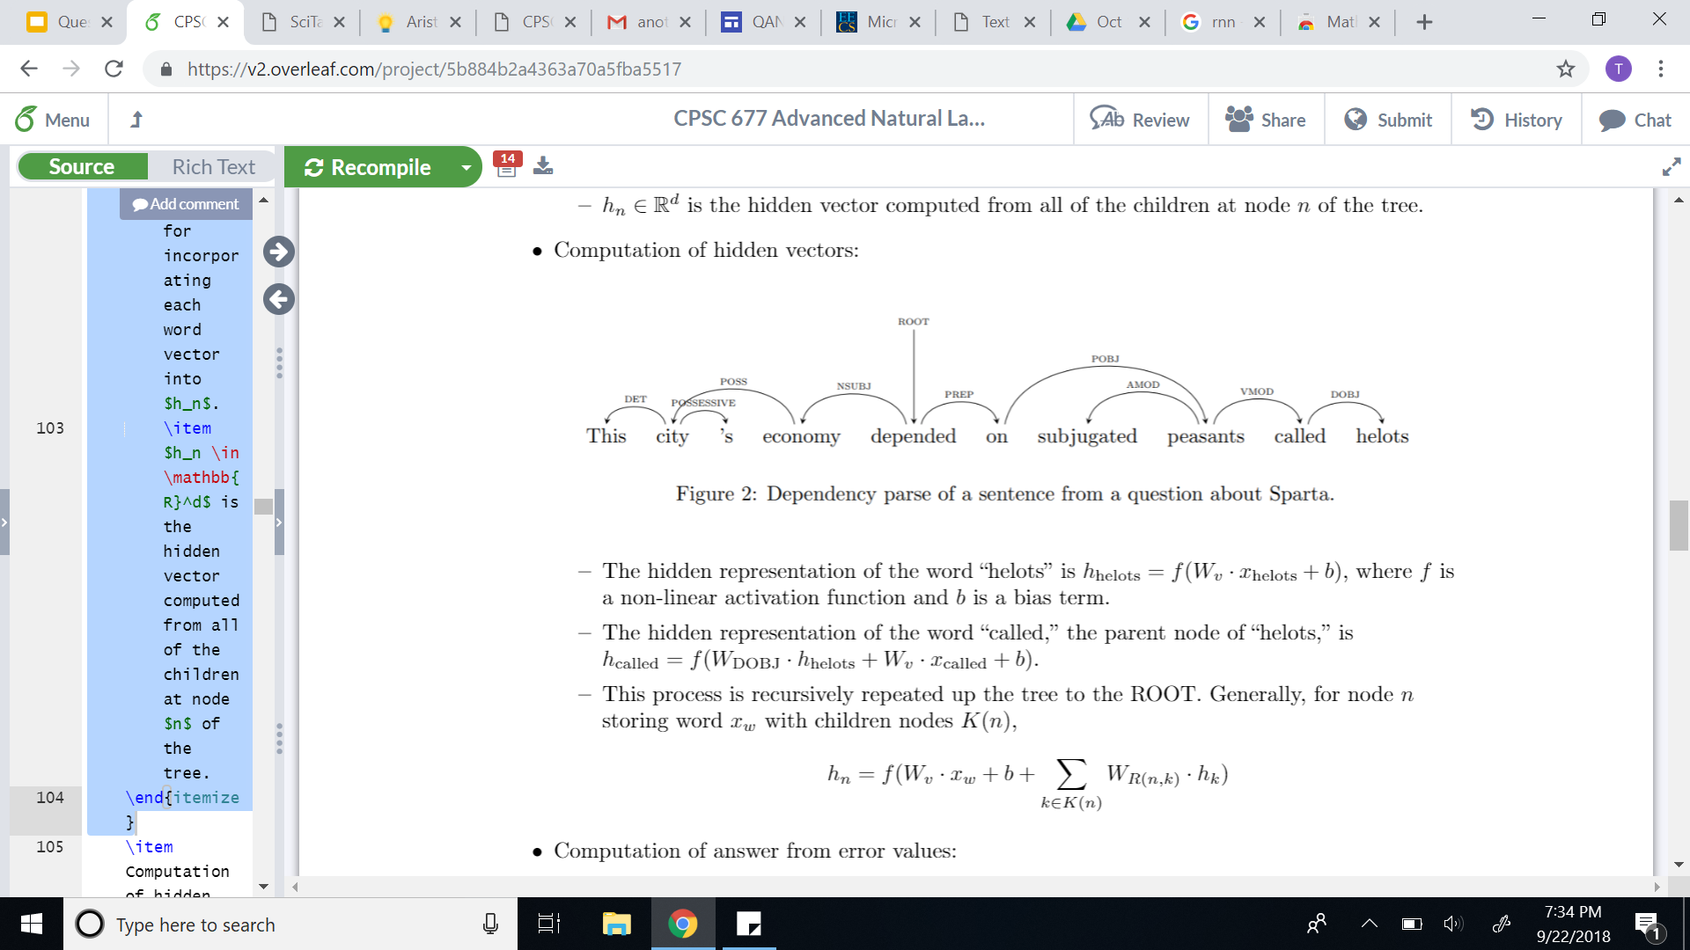
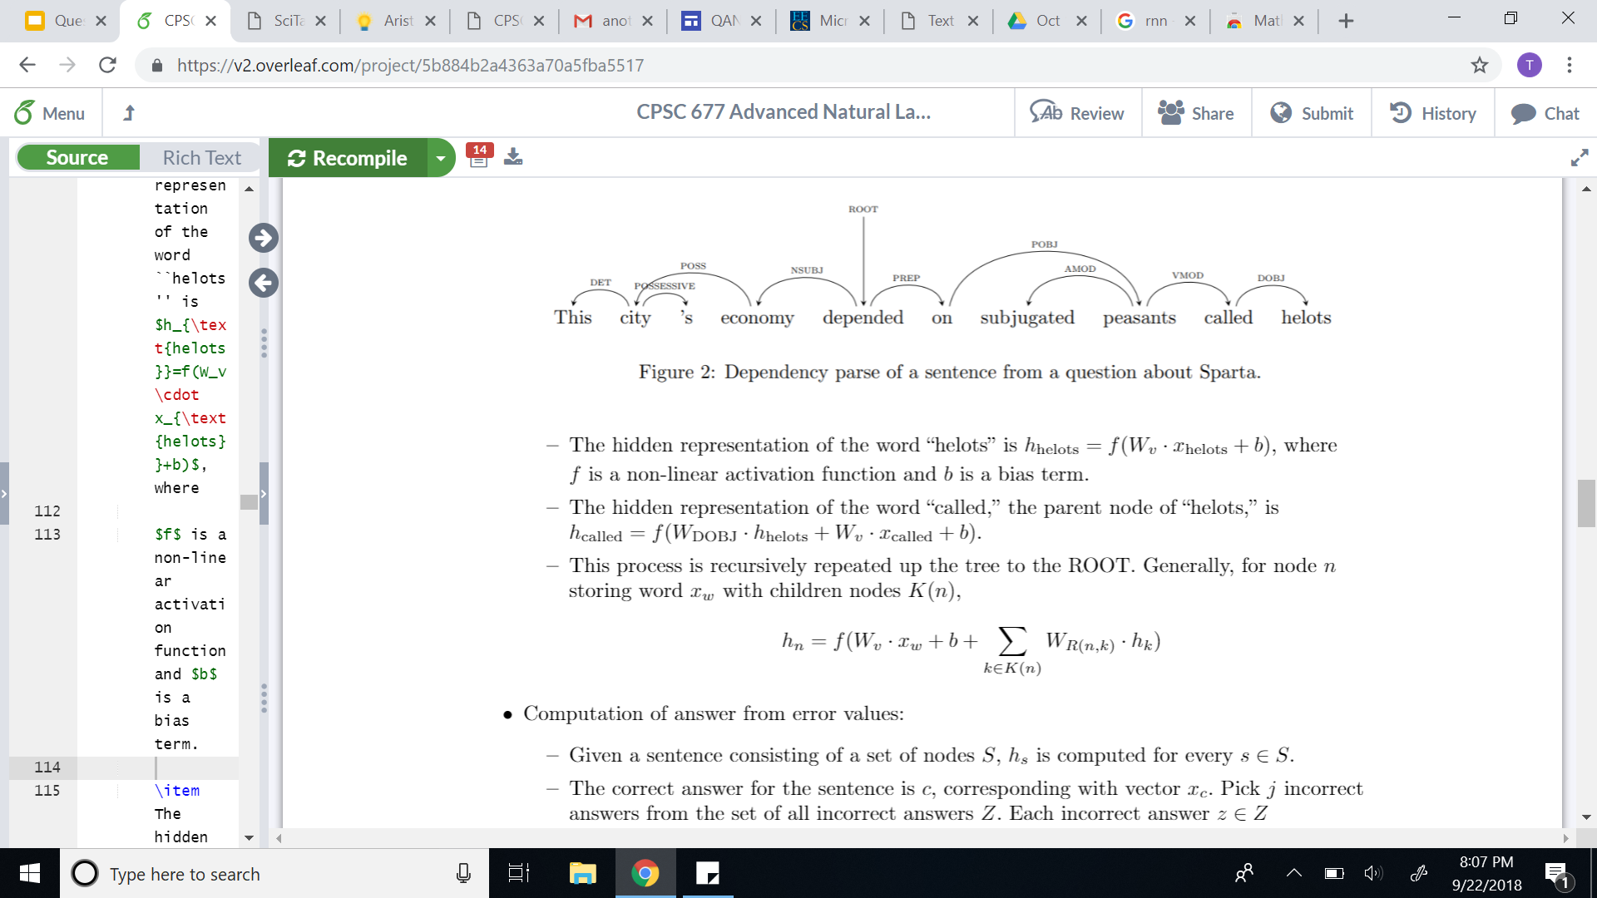
(QANTA): A Neural Network for Factoid Question Answering Over Paragraphs
Recursive computation of hidden vectors:
Iyyer, Mohit et al. “A Neural Network for Factoid Question Answering Over Paragraphs.” 2014.

Slide 72
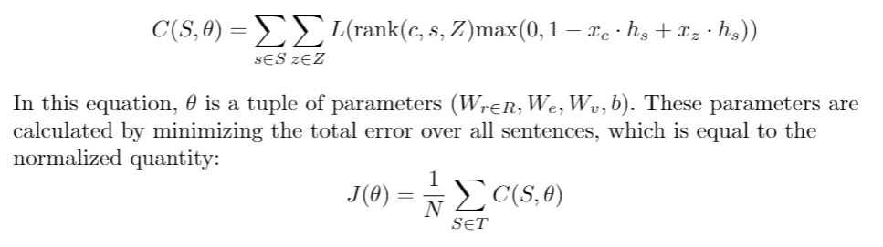
(QANTA): A Neural Network for Factoid Question Answering Over Paragraphs
objective
Iyyer, Mohit et al. “A Neural Network for Factoid Question Answering Over Paragraphs.” 2014.

Slide 73
(QANTA): A Neural Network for Factoid Question Answering Over Paragraphs
Experiments:
QANTA was trained on questions used in Quiz Bowl tournaments between 1998 and 2013.
Only questions from the History and Literature sections were used (as these were the largest datasets).
Both questions and answers were altered to make keyword recognition more feasible (using Whoosh).
Iyyer, Mohit et al. “A Neural Network for Factoid Question Answering Over Paragraphs.” 2014.

Slide 74
(QANTA): A Neural Network for Factoid Question Answering Over Paragraphs
Sample QuizBowl question:
These substances can use either using a ping-pong mechanism or a ternary complex intermediate.
One model of them defines the parameters K-m and V-max and uses a steady-state approximation.
They can be inhibited non-competitively and competitively, and the change in their structure during substrate binding is described by the (*) induced-fit model. They can be allosterically regulated and perform their action at their active site. For 10 points, name these proteins that catalyze reactions.
https://docs.google.com/viewer?a=v&pid=sites&srcid=d2xwcy5uZXR8d2xocy1xdWl6LWJvd2x8Z3g6Mzk2ZmQ5ZTJiMmRjNzljMg

Slide 75
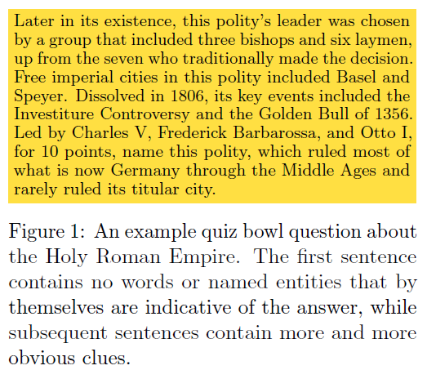
Quiz Bowl Questions
[Iyyer et al. 2014]

Slide 76
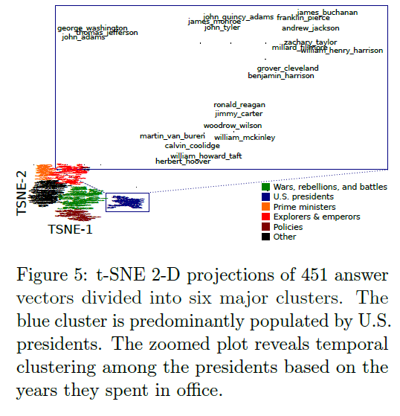
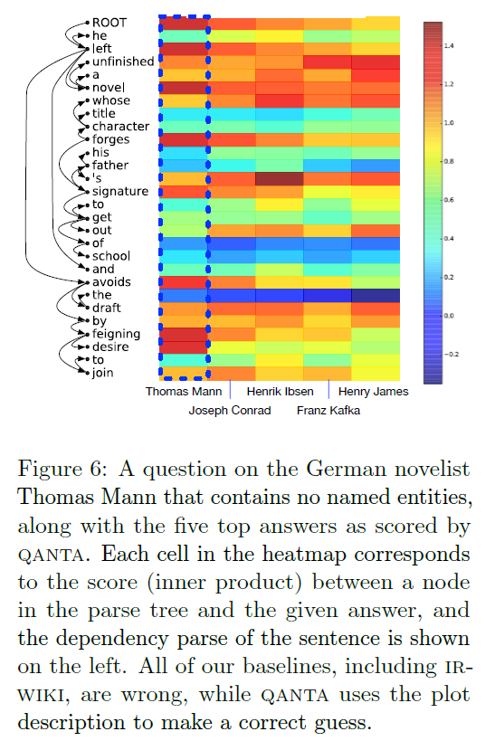
[Iyyer et al. 2014]

Slide 77
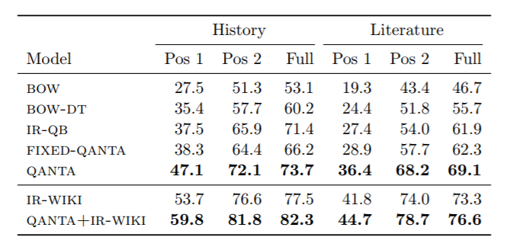
(QANTA): A Neural Network for Factoid Question Answering Over Paragraphs
Performance:
Iyyer, Mohit et al. “A Neural Network for Factoid Question Answering Over Paragraphs.” 2014.

Slide 78
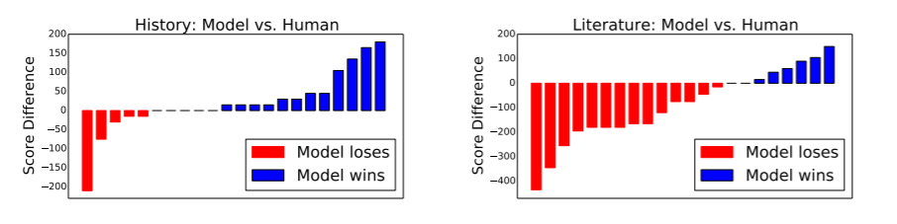
(QANTA): A Neural Network for Factoid Question Answering Over Paragraphs
Performance:
Iyyer, Mohit et al. “A Neural Network for Factoid Question Answering Over Paragraphs.” 2014.

Slide 79
(QANTA): A Neural Network for Factoid Question Answering Over Paragraphs
Summary:
QANTA outperforms BOW and IR models in answering factoid, pyramidal questions.
This paper contributes a model that understands and applies sentence compositionality to question answering.
Iyyer, Mohit et al. “A Neural Network for Factoid Question Answering Over Paragraphs.” 2014.

Slide 80
Links about QANTA
https://cs.umd.edu/~miyyer/qblearn/
A Neural Network for Factoid Question Answering over Paragraphs
Mohit Iyyer, Jordan Boyd-Graber, Leonardo Claudino, Richard Socher, and Hal Daumé III
EMNLP 2014
https://cs.umd.edu/~miyyer/data/question_data.tar.gz
https://cs.umd.edu/~miyyer/qblearn/qanta.tar.gz

Slide 81
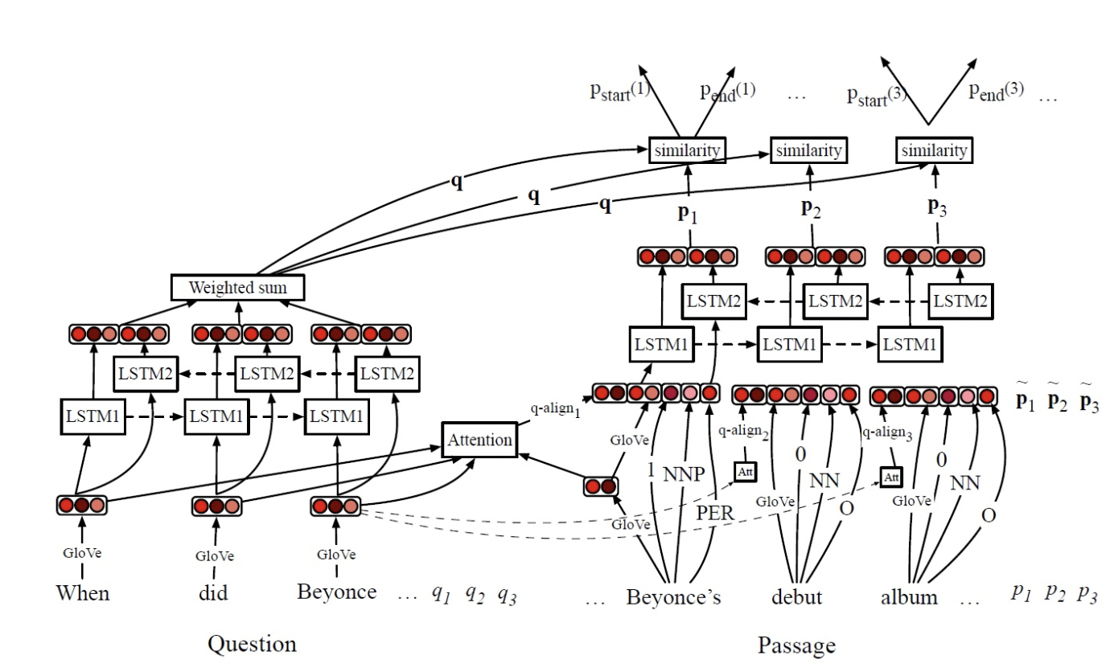
DrQA: document reader question answering
predicted probability of start and end token position in paragraph p_start(i), p_end(i)
Output layer
Alignment layer (question-to-context attention)
a single question embedding q
a sequence of token embeddings in paragraph
Encoding layer
aligned question embeddings
Embedding layer
Input layer

Slide 82
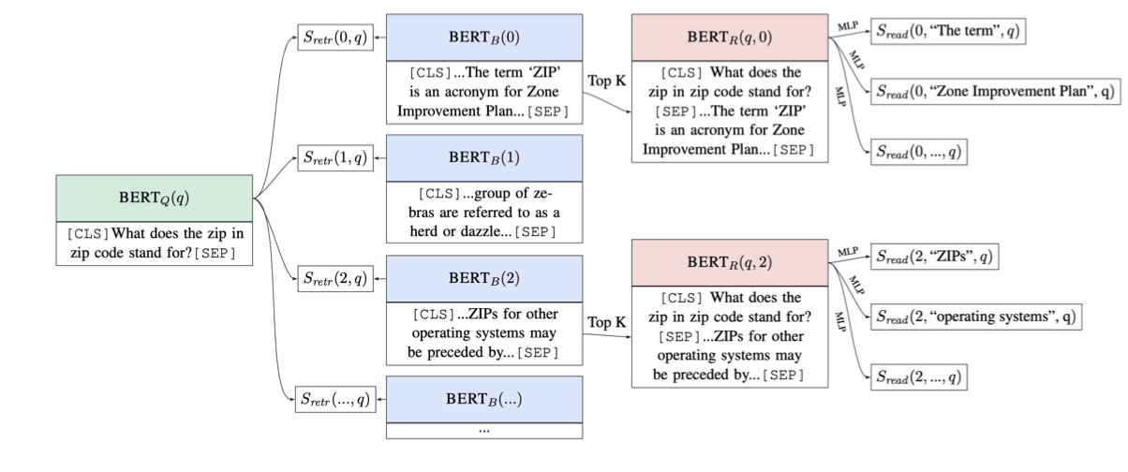
ORQA: Open Retrieval Question Answering system
Retriever
Reader
retriever score
reader score
answer
question
Lee et al., 2019 Latent Retrieval for Weakly Supervised Open Domain Question Answering

Slide 83
QA Dataset

